Slide 1


Break a sweat
(FITNESS AND TRANING CENTRE )
TEAM MEMBERS:DEEPIKA MANI(21AG1A05E2)
:MADHU BALA(21AG1A05E8)

Slide 2
Introduction:
Gyms are become the essential part of our lives, providing best exercise and body building facilities to our society.
It is a place for indoor physical workout where various equipment and machines are typically used.

Slide 3
OBJECTIVE:
The main objective of developing this project is to
create a website for the gym , for which user can get details of the gym , such as about the gym , contact details , address , images etc.

Slide 4
PAGES OF THE PROJECT:
Home Page: It contains the basic information about the Gym.
About Page: It contains all information about the Gym and their working.
Gallery Page: This contains all images about Gym management.
Register Page: Here Users can easily register on the Gym website and confirmation message will be displayed after registering.

Slide 5
Register Page: Here Users can easily register on the Gym website and confirmation message will be displayed after registering.
Contact Page : User can submit their contact details on the Gym website.
Login : User can log in on the Gym website.

Slide 6
Technology used in the project:
HTML : Page layout has been designed in HTML.
CSS : CSS has been used for all the designing part.
JavaScript : All the validation task and animations have been developed by JavaScript.

Slide 7
HARDWARE CONFIGURATION:
Processor:11th Gen Intel(R) Core(TM) i3-1115G4 @ 3.00GHz 3.00 GHz.
RAM : 8.00 GB (7.74 GB usable).
System Type : 64-bit operating system, x64-based processor.
Mouse : 3 buttons.

Slide 8
Software configuration:
Operating system : Microsoft Windows
Web Browsers : Chrome , Microsoft edge..

Slide 9
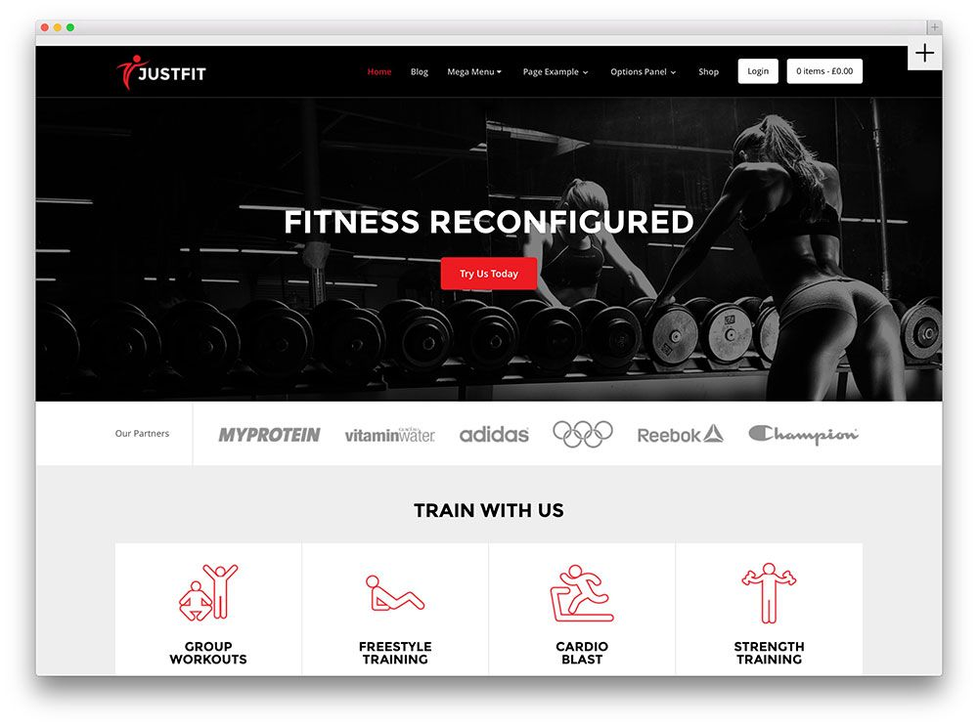

Slide 10


THANK YOU

